Slide 1
BREECH PRESENTATION
Dr. Ali F. Al-Assadi
Prof. Of Obst & Gyne.
Basra Medical College

Slide 2
Aetiology
1- Preterm delivery →25 wk -------30%
→ 32wk-------15%
→ term --------3%
2- Twin pregnancy.
3- Uterine anomalies.
4- Oligo- & Poly- hydramnios.
5- Placenta previa,
6- Multipara.
7- Hydrocephaly.
8- IUD.
9- Pelvic tumours.

Slide 3
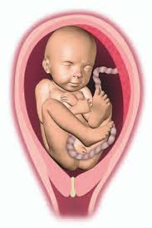
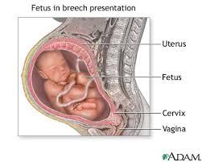
Diagnosis
A- During pregnancy
1- Abdominal examination: the head occupies the fundus, FH is heard at the level or slightly
above the maternal umbilicus.
2- Ultrasound exam. Or X-ray.
B- During labour: After rupture of the mem, the breech (irregular, soft, no suture line) can be felt, & the anus, scrotum & sacrum, in flexed breech foot can be felt.

Slide 4
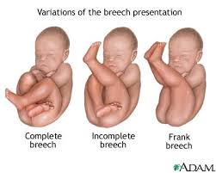
Types of breech
1- Extended or Frank: 60% ,legs are extended beside the body more in primigravida & near term, less difficult in delivering the after coming head.
2- Flexed or Complete:
hips & knees are flexed.
The presenting part is irregular
& less pointed so early
engagement is less likely &
cord prolapse is more common.
3- Footling Or Incomplete : one or both feet are presenting. Greater risk of cord prolapse & difficult delivery of the after coming head.

Slide 5
Complications of vaginal breech delivery
A- Mother: Sepsis, injury to the birth canal & danger of emergency anesthesia.
B- Child: Increase PNM, preterm complications, congenital anomalies, injury to the fetus.
Stillbirth result from intracranial hemorrhage & asphyxia.

Slide 6
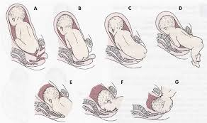
Mechanism of labour
4 positions are described L & R sacroanterior & L & R sacroposterior. In most case the bitrochantric diameter ( 10 cm) engages in the transverse diameter of the pelvis with the back to the front. During labour the breech descends & internal rotation brings the bitrochantric
diameter into the A-P diameter
of the pelvic outlet. The breech is
born by lat. Flexion of the trunk, the
rest of the trunk is born by further
Descent, together with the arms
which normally remain flexed in
front of
It.

Slide 7
Mechanism of labour. (Cont.)
The ant shoulder delivers 1st under the pubic arch & followed by the post shoulder. The flexed head engages in the transverse diameter of the brim, followed by internal rotation in the pelvic cavity with the occiput coming to lie behind the symphysis pubis,

Slide 8
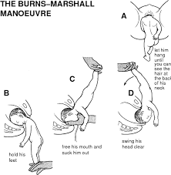
Mechanism of labour. (Cont.)
At the same time the back rotate ant, the neck rests against the pubic arch as the head is born by the face sweeping over the perineum & the baby born by backward lifting
onto the maternal abdomen.
Posterior rotation of the occiput
occur infrequently & then the
head is born by face to pubis.

Slide 9
Management (ECV)
All cases must be delivered in a hospital by experienced obstetrician.
External cephalic version: The fetus is turned to a head presentation by manipulation through the mother’s abdominal wall.
Contraindications:
1- Placenta previa & contracted pelvis.
2- IUD & severe congenital anomalies.
3- ROM, oligohydramnios, twin pregnancy & lack of uterine relaxation.
4- Severe HT & severe IUGR.
5- Scared uterus.

Slide 10
Management (ECV)
Complications:
1- Placental separation.
2- Cord entanglement.
3- PROM.
4- Preterm labour.
5- Uterine scar dehiscence.
6- Transplacental hemorrhage with Rh sensitization.

Slide 11
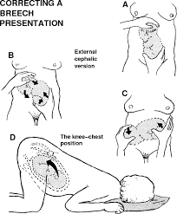
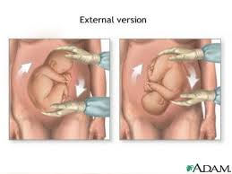
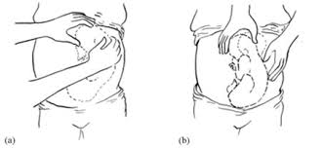
ECV Procedure
Usually done between 36-38 wk. because before 36 wks spontaneous version occur in a large proportion of cases & after 38 wk it will be difficult due to decrease liquor vol.

Slide 12
Management of persistent breech presentation
The patient must be thoroughly assessed so that the correct rout for delivery must be chosen.
1- Assess the size & shape of the pelvis using clinical examination, X-ray or CT scan.
2- Assess the size of the baby by clinical exam & ultrasound.
3- Exclude extension of the fetal neck→ mentovertical diameter (13 cm) meeting the brim which will cause obstruction.

Slide 13
Elective caesarean section
Breech + any additional risk factor.
1- DM.
2- Moderate to severe HT & PE.
3- Placenta previa.
4- Rh isoimmunization.
5- IUGR.
6-pelvic abnormality.
7- Body wt > 3.5 kg.
8- hyperextended head.
9- BOH & infertility.
10- Previous CS.
11- preterm with body wt < 1.5kg.

Slide 14
Vaginal Breech Delivery
Should be in a unit equipped for CS.
Fetal heart monitoring facilities must be available.
Management or 1st stage:
Those patient may require GA at any time so adequate fluid & dextrose IV should be given to avoid ketosis, as well as they should have only sips of water orally, other measurements are as in normal delivery.
Management of the 2nd stage:
1- Spontaneous Breech delivery. Usually in multipara, carry a risk of perinatal mortality.
2- Assisted Breech delivery.
3- Breech Extraction.

Slide 15
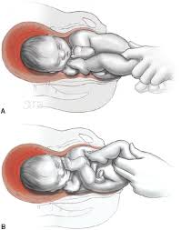
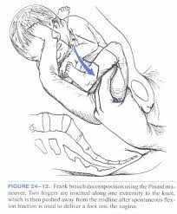
Assisted Breech Delivery.
Confirm full cx dilatation before allow the pt to push
Lithotomy position when the breech reaches the pelvic floor.
Episiotomy as soon as the babies anus become visible at the height of contraction
Epidural or Pudendal block or
LA
before episiotomy
Delivery of the buttocks
& legs should be spontaneous,
Assistant may be required to
deliver the extended legs by
Pinard maneuver ( flexion of
the hips & knees then tract on the appearing foot).

Slide 16
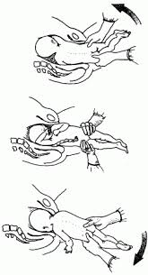
Assisted delivery of the trunk
As soon as the umbilicus is born pulsation in the cord should be checked to exclude cord compression. A finger should be inserted through the vagina to make certain that the arms are lying folded on the chest & the fetal back should be kept anterior as soon as the inferior angle of the scapula becomes visible at the interoitus, the ant
arm can be gently hooked out,
after which the posterior arm
can be released. If the arms are
extended delivery can be done
by Loveset’s Maneuver.

Slide 17
Assisted delivery of the trunk
By downward traction the ant shoulder is brought to lie behind the symphysis, the inferior angle of the scapula is outside when this is done the post shoulder will lie below the brim, the fetus then turn through 180º with the back upwards, while moderate traction is maintained.

Slide 18
Assisted delivery of the trunk
By this means the post arm is brought to the front & inevitably delivered either spontaneously or easily hooked out with the finger. The fetus then rotated again 180º in the opposite direction, the back kept upward & the remaining arm will be delivered.

Slide 19
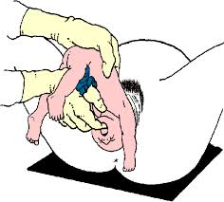
Delivery of the head
The body is allowed to hung down to exert slight traction in the direction of the pelvic axis & as the head descended, the nap of the neck can be seen below the pubic arch, the body if lifted to the horizontal position, the face then appear at the vulva & the head then delivered slowly & carefully. Any difficulty in delivery of the head should be avoided because of risk of hypoxia & death, this can be managed by either using a forceps or if the fetal head is at a high level then exclude hydrocephalus & CPD, then the head flexion is completed by passing one hand up in front of the fetal thorax where one finger press on the jaw, the other hand is passed along the back until
the index & middle fingers
can curve over the shoulder
to exert traction ( Jaw & shoulder
traction or Mauriceau- Smellie-Veit method).

Slide 20
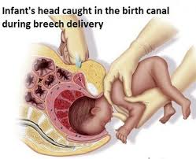
Delivery of the head (cont)
The head is drawn down & if necessary rotated until the neck lies under the pubic arch & delivery is completed with forceps.
If the occiput rotated posteriorly delivery can be helped with the use of forceps.

Slide 21
Assisted Breech Video

Slide 22
Breech Extraction
The obstetrician delivers the infant with no assistance from the mother. The method has been used to expedite labour in case of fetal distress or cord prolapse. Occasionally when progress ceased in the second stage or for delivering the 2nd twin, ( the cx must be fully dilated with adequate liguor volume, the uterus may be relaxed by GA & there should be on CPD.

